Slide 1
ENGI 301 PCB Project
<Jonathan Lloyd>
Due 12/13/2022 @ 11:59pm

Slide 2
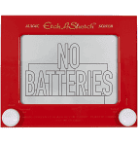
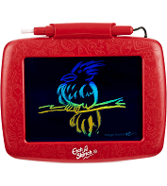
Background Information
Create a PCB for an “Etch-a-Sketch”
Hardware:
SPI Display Screen
Two Potentiometers
Two Buttons (Reset the Game, Change Color)
Three LEDs (Red, Green, and Blue for Color)
USB Port (Expansion)

Slide 3
System Block Diagram – “Etch-a-Sketch”
5V (P2_13)
3.3V (P1_14)
PocketBeagle
USB Host
VCC
SPI Display
USB
SPI
SPI
VCC
USB
SPI
GPIO
GPIO
GPIO
GND
3.3V
GND
GND
1k
1.8V
Potentiometer
3.3V
GPIO
1k
AIN (P1_21)
GPIO
AGND (P1_17)
GPIO (P2_02)
1.8V
Potentiometer
GPIO (P2_04)
AIN (P1_23)
AGND (P1_17)
GPIO (P2_06)

Slide 4
Mechanical Drawing
6.35 mm
5”
31.75 mm
Pot
SPI Display
Pocket Beagle
Tricolor LED
Pot
4”
microSD
USB
Button
Button
microUSB
microSD
31.75 mm
12.7 mm
FRONT
FRONT
BACK
BACK

